Slide 1
Chimera - Seeing
Twinkle, twinkle, little star, How I wonder ...

Slide 2
Why do stars twinkle?
The twinkling of stars (stellar scintillation) is caused by the refraction of light as it passes through the Earth’s atmosphere.
The light is refracted due to the movement of air.

Slide 3
Seeing
Seeing is, essentially, a measure of the steadiness of the air.
It is a value which describes the quality of the atmospheric conditions at the time of observation.
Seeing, measured in arc-seconds, is a determinate in the resolution of the images observed by a telescope. Lower seeing values implies better resolution which results in clearer pictures.

Slide 4
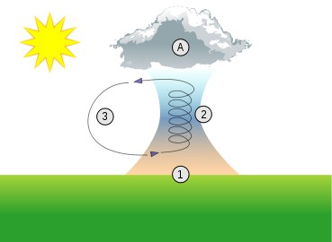
What affects seeing?
Variations in the seeing are caused by rapid, small scale turbulences within the atmosphere.
These turbulences are caused by thermals, wind gusts, suspended air particles, air moisture etc.
Best conditions for seeing are clear, cold nights without wind gusts.
The best seeing values are obtained from observatories on mountain tops.

Slide 5
Why is seeing important?
Poor seeing will result in small, erratic movements of the observed object. Creating a fuzzy or blurred image.
These slight movements may be significant enough to void an entire night of captured images.

Slide 6
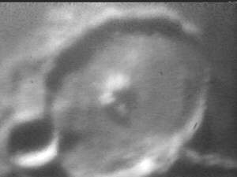
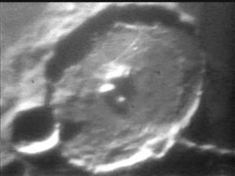
The effects of poor seeing are more apparent when observing near by objects, such as planets or moons.

Slide 7
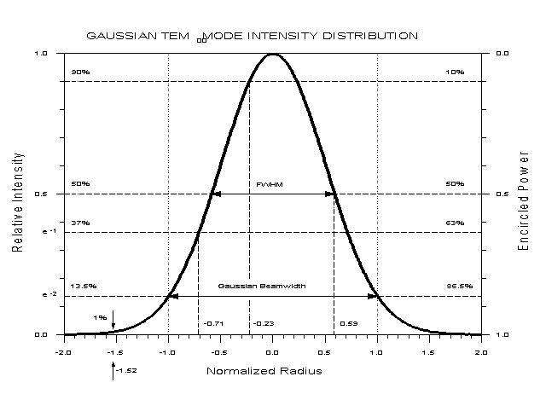
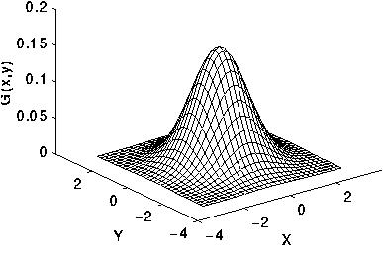
Measurement
The flux of a point source (star) is naturally mapped as a Gaussian Distribution.
The seeing is determined by the radius of the Full Width at Half Maximum (FWHM) of the flux of a point source.

Slide 8
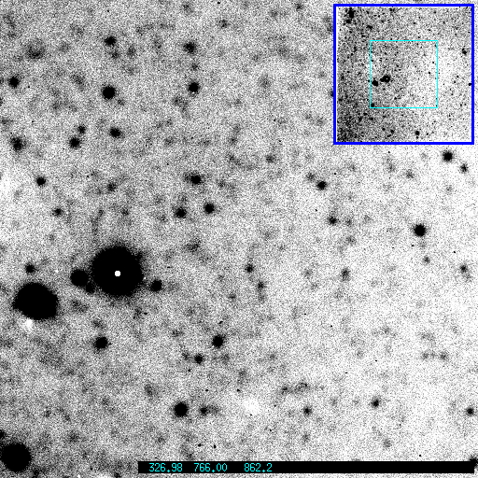
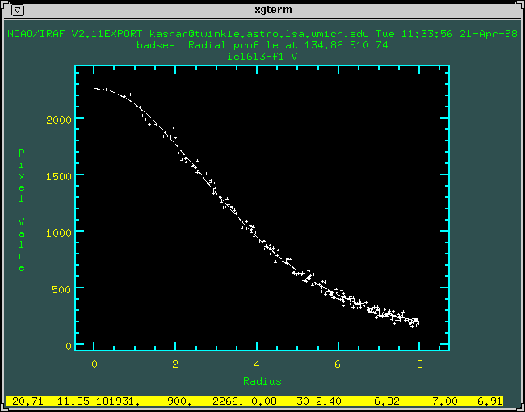
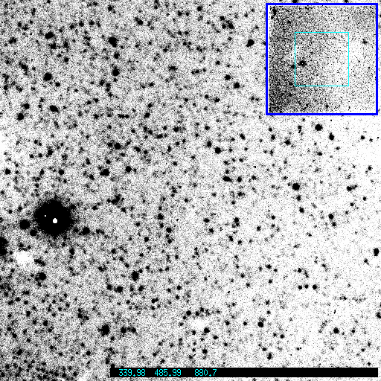
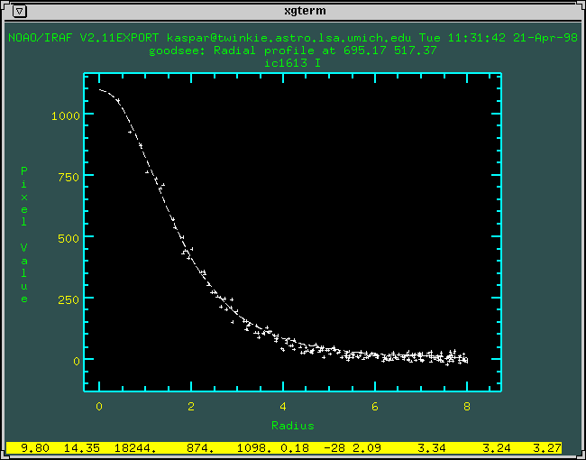
Examples

Slide 9
SExtractor
SExtractor is a program which extracts point sources from a fits file.
We use SExtractor to calculate the following:
RA/DEC of individual stars in an image
Instrumental Magnitude
Star flux
Seeing

Slide 10
Seeing.py
Seeing.py is a python module which configures SExtractor to perform different operations based on the needs of the user.
The seeing.py module is able to:
Find a star in a fits images based on its RA/DEC
Find the brightest stars in a fits image

Slide 11
Default operations
Our module will write the brightest stars in the image to the database.
10 stars are found unless otherwise specified by the user.
Seeing.py runs through the catalog of stars output by SExtractor.
It keeps a list of the brightest stars which is overwritten each time a brighter star is found.
def __getBrightestStars(self, nStars):
for star in self.catalog:
i = 0
for storedStar in self.brightestStars:
if star['MAG_BEST'] <=
stored['MAG_BEST']:
self.brightestStars.insert(i, star)
if len(self.brightestStars) > nStars:
self.brightestStars.pop();
break
i = i + 1
if len(self.brightestStars) < nStars:
self.brightestStars.append(star)

Slide 12
Finding a star by RA/DEC
The RA/DEC of a requested star is supplied to our module.
After SExtractor identifies the RA/DEC of each star in the fits image, our module iterates through the catalog of found stars and finds the closest star to the supplied RA/DEC.
The closest star is written to the database.
def __getStarClosestTo(self, RA, DEC):
minDistance = 100000
closestStar = None
self.catalog = SExtractorfile("test.cat")
for star in self.catalog:
currentDistance = self.__distanceBetween (star[‘X_WORLD'] , star['Y_WORLD'], RA, DEC)
if(minDistance > currentDistance):
minDistance = currentDistance
closestStar = star
return closestStar

Slide 13
Using seeing.py
Example code to run our module:
seeing.py runs SExtractor with our configuration.
dss_search.fits is the image which is run through SExtractor.
import seeing
see = seeing.Seeing()
see.writeBrightestStars(starID, filepath, nStars)
see.writeStarClosestTo(starID, filepath, RA, DEC)

Slide 14
Top 3 brightest stars and closest star to RA/DEC
----------------------------------------
Running SExtractor on .fits image: images/dss_search.fits
Generated command line: sex -c seeing.sex images/dss_search.fits
========================================
Finished running sextractor...
========================================
Writing the following star to the database...
----------------------------------------
Star # 1324
X/Y Position = ( 493.507 , 491.658 )
RA/DEC = ( 299:52:29 , -29:53:39 )
RA/DEC = ( 299.87474451 , -29.894287547 )
MAG_BEST = -15.3995
FLUX_BEST = 1444808.0
FWHM_WORLD = 0.003009378
========================================
Writing the following star to the database...
----------------------------------------
Star # 1011
X/Y Position = ( 201.891 , 123.45 )
RA/DEC = ( 300:02:07 , -30:04:01 )
RA/DEC = ( 300.03538815 , -30.066988792 )
MAG_BEST = -15.0459
FLUX_BEST = 1043206.0
FWHM_WORLD = 0.003148303
========================================
Writing the following star to the database...
----------------------------------------
Star # 1041
X/Y Position = ( 394.986 , 119.258 )
RA/DEC = ( 299:55:48 , -30:04:11 )
RA/DEC = ( 299.93006903 , -30.069746035 )
MAG_BEST = -14.8487
FLUX_BEST = 869936.3
FWHM_WORLD = 0.002427142
========================================
Searching for the closest star to RA = 300.04456 and DEC = -30.01189
Found star at RA = 300.04303062 , DEC = -30.011222375
----------------------------------------
Writing the following star to the database...
----------------------------------------
Star # 748
X/Y Position = ( 186.793 , 241.43 )
RA/DEC = ( 300:02:34 , -30:00:40 )
RA/DEC = ( 300.04303062 , -30.011222375 )
MAG_BEST = -13.8926
FLUX_BEST = 360617.0
FWHM_WORLD = 0.001355666
========================================

Slide 15
References
Image 1 - http://www.enchantedlearning.com/subjects/astronomy/stars/twinkle.shtml
Image 2 - http://upload.wikimedia.org/wikipedia/commons/thumb/f/f0/Thermal_column.svg/369px-Thermal_column.svg.png
Image 3 - http://en.wikipedia.org/wiki/Astronomical_seeing
Images 4,5 - http://schmidling.com/seeing.htm
Image 6 - http://www.coseti.org/9101-001.htm
Image 7 - http://www.cse.cuhk.edu.hk/~csc5280/project1/project1/NG_WONG/Project1.files/image002.gif
Images 8,9 - http://spider.ipac.caltech.edu/staff/kaspar/obs_mishaps/images/seeing.comp.html
Image 10 - http://spider.ipac.caltech.edu/staff/kaspar/obs_mishaps/images/badsee.radial.html
Image 11 - http://spider.ipac.caltech.edu/staff/kaspar/obs_mishaps/images/goodsee.radial.html

